Slide 1


Data Analytics &
Visualisation

Slide 2


Today's agenda
Project recap
Problem
The Analytics team
Process
Insights
Summary

Slide 3

Reading and analysing a client project Social Buzz..
recommendation for IPO
Analysing top 5 popular categories of content
Project Recap

Slide 4

Massive Scale of data .

Slide 5



Chief Technology Architech:Andrew Fleming
The Analytics Team
Senior Principal:Marcus Rompton
Data analyst: Fouzia Khatoon

Slide 6
Process
1. UnderStanding & Analysing
2. Data cleaning
3. Data Modelling
4. Data Visualisation
5.Uncover Visualisation

Slide 7
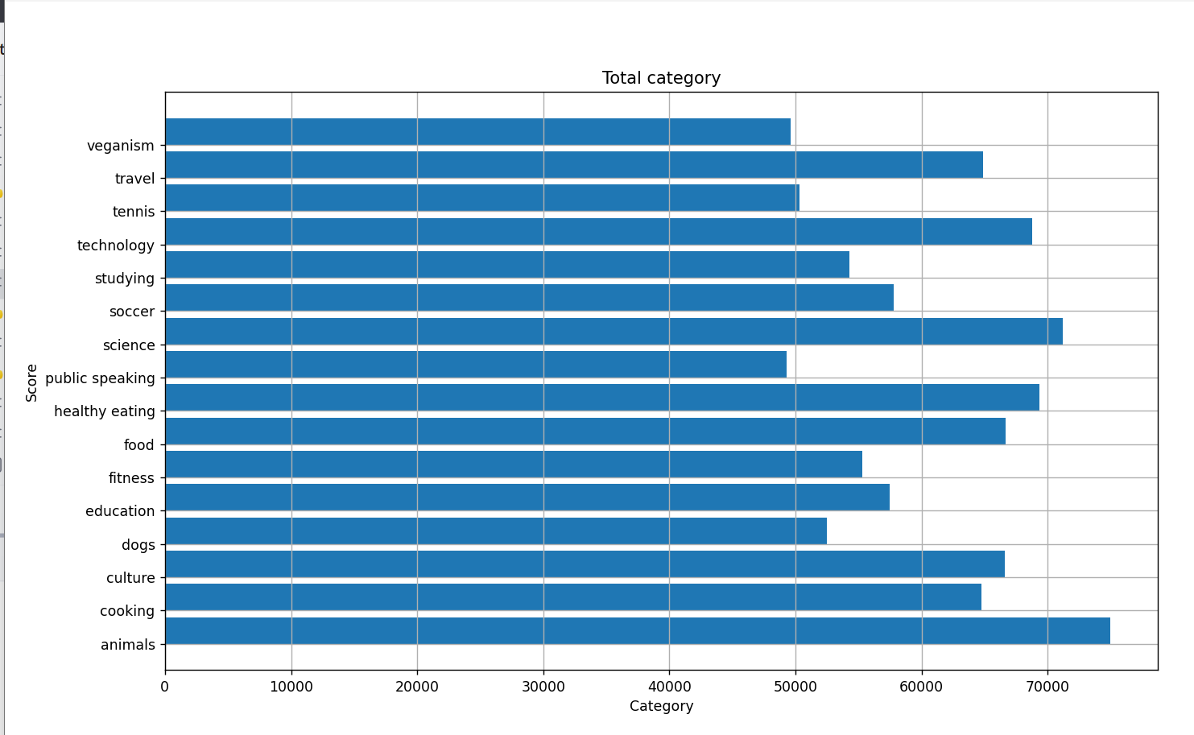
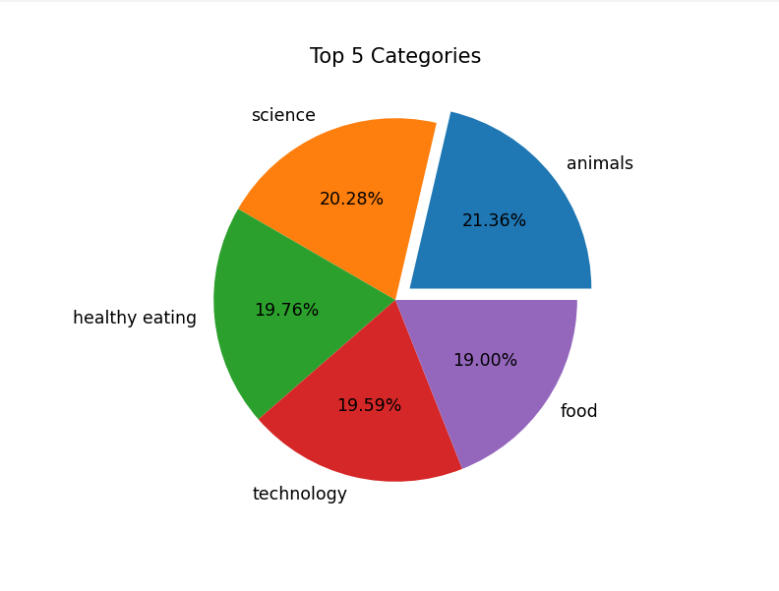

Insights

Slide 8
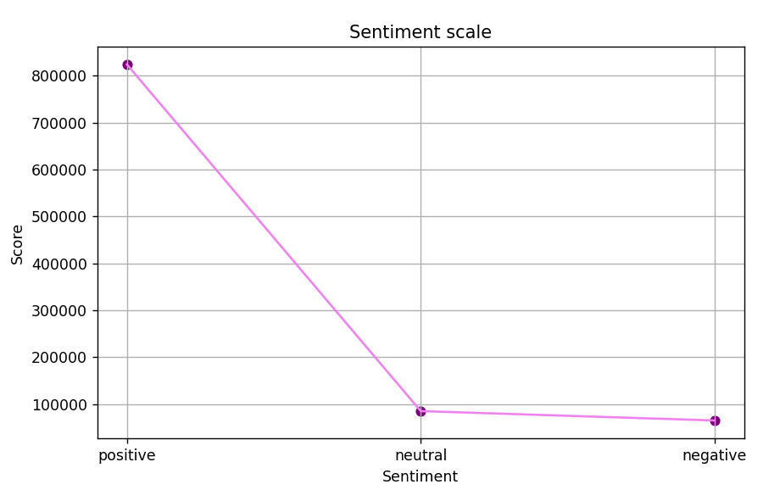
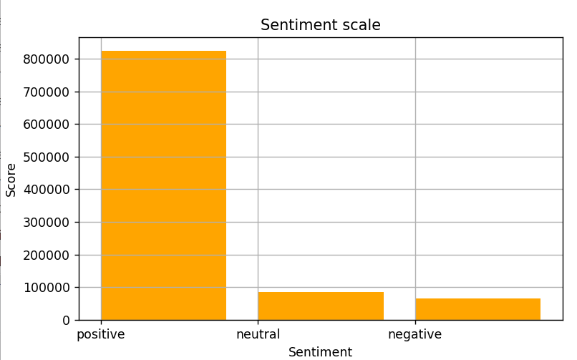

Slide 9
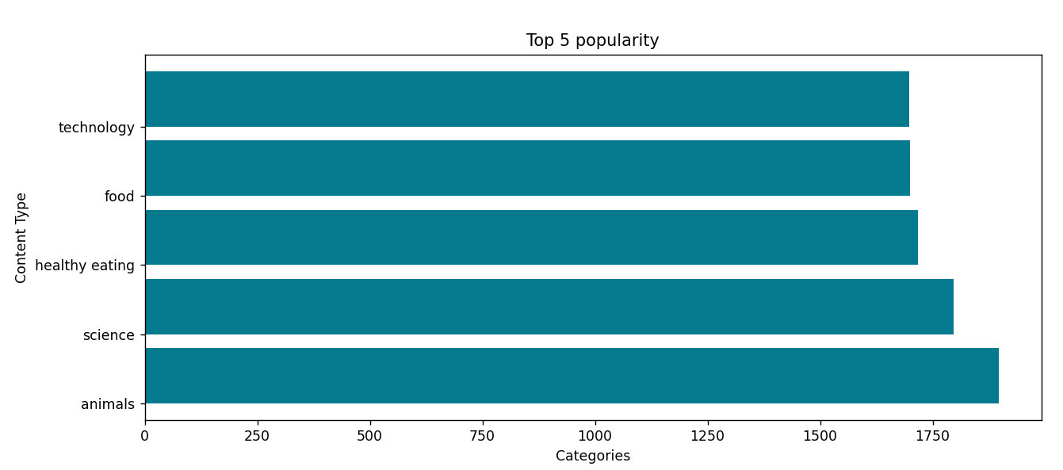

Slide 10

Shown top five categories in a pie chart.
Shown Sentiment of different people with their personal opinion
Shown in a bar graph top 5 content category . It shows the popularity
Summary

Slide 11
Thank you!
ANY QUESTIONS?

